Slide 1
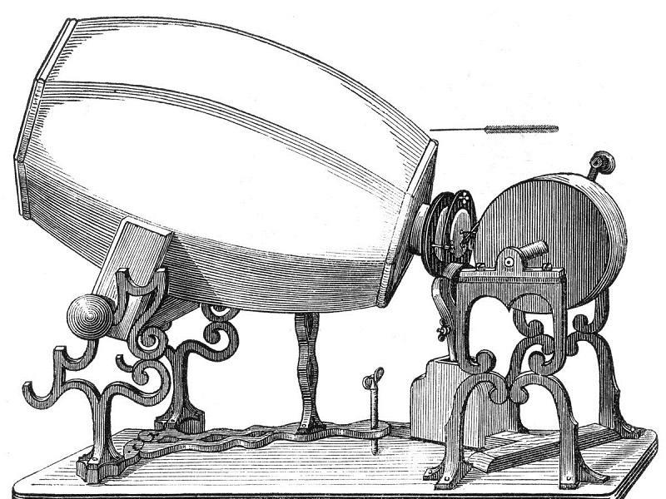
UNOFFICIAL
Using Machine Learning for Qualitative Analysis March 14, 2019
This is a diagram of Edouard-Leon Scott's 1857 invention, the phonautograph. This device was created to show the wave that sound creates and could not play the sound back to you.
U.S. PUBLIC DOMAIN
These slides support a talk and come from a more complete presentation: https://docs.google.com/presentation/d/1lq23IrSW9ndfrHkZTGoU5Mx2XFoJIvbKXezO3BmcRiE/edit?usp=sharing

Slide 2
Related projects - AI for Public Engagement
Open Government
Open North: Data Reuse and Data Literacy
“Prior art”: Topic Modelling and Cybersecurity Entrepreneurship
Ottawa Civic Tech
PCO Learning Bundle
PCH Polis project

Slide 3



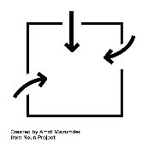






Methodology
We tracked everything we heard and every comment we received, regardless of whether it was said at a workshop, tweeted, emailed, or written online.
Our team then worked to categorize each comment by theme. We looked at whether the comments would match up to an existing commitment or whether they represented a new potential area of work.
We then negotiated with potential partners to determine feasible commitments and published draft documents for public consultation.
Finally we release the plan and begin implementation and monitoring.
1. Engage and listen
Get involved questionnaire.
Engagement activities online & in-person.
Make it easy to provide useful input.
2. Document & collect
Capture comments, transcribe, clean up, transform for consistency.
Accurately gather what we are hearing.
3. Group & analyze
Code for relevance and emerging themes. Iterative reports, discovery & sense making.
Understand what we are hearing
4. Share, discuss & decide
Grouped comments shared with potential partners. Incorporated into draft commitments where possible.
Integrate what we are hearing.
5. Act & report
Data and What We Heard released with draft report. Implementation dashboard.
Demonstrate impact.
Notes:
Icons are from https://thenounproject.com and are licenced creative commons. The credits should be made visible at the end of the document.

Slide 4
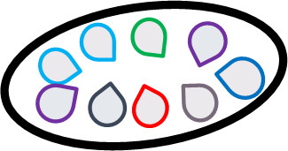

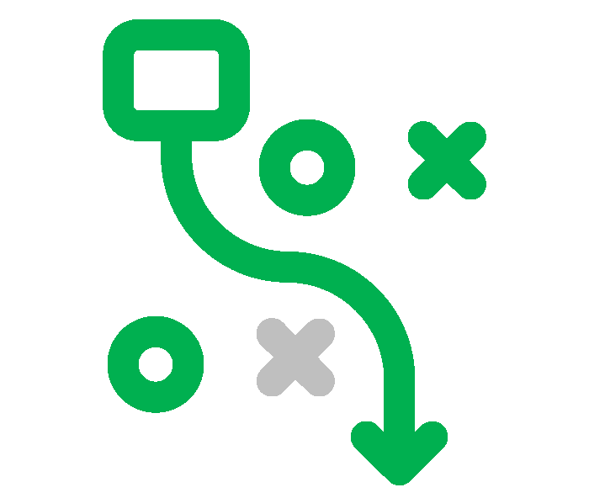
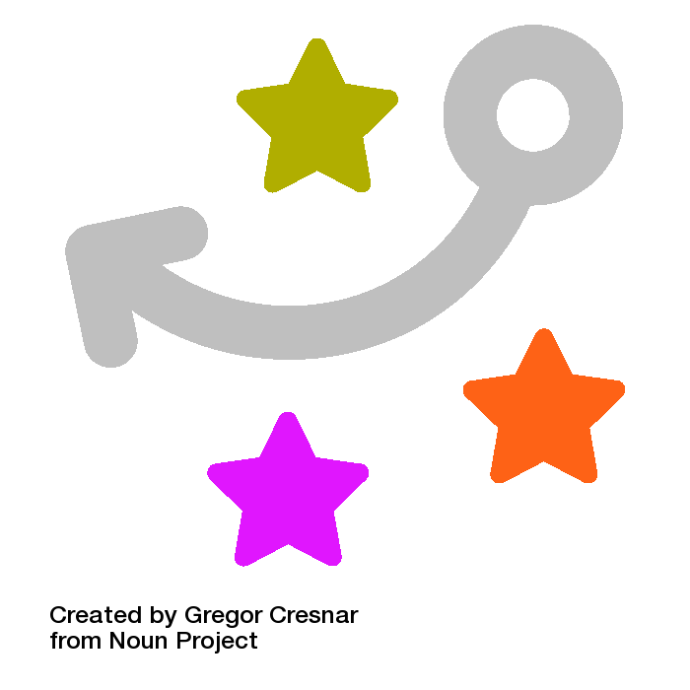
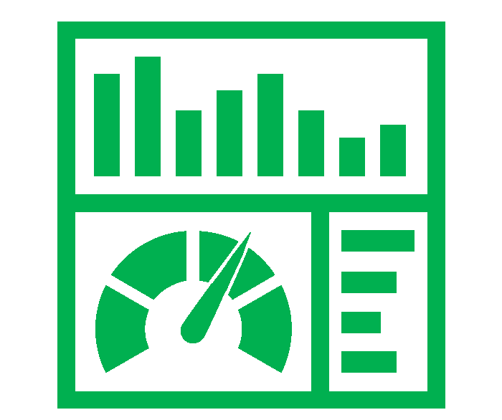
Development Process
Draft V.05 June 2018
Creating a multi-faceted policy document is a complicated process with many participants.
This diagram provides a simplified overview of the creation of a two year plan for open government.
The colour of the arrows reflects a subjective evaluation of the degree of process transparency.
Engage and listen to learn about needs – document and collect ideas and themes.
Group and analyze comments, share with partners, commitment conversations & collaboration
Act & report, negotiation, briefing, text wrangling and publishing.
Policy & Implementation Teams
Minister’s Office
Cabinet
Community Input
Multi-stakeholder Forum
Priorities & Directions
Analysis & proposed commitments negotiation
Public Comment
Draft Plan
Practices & Successes
Final Plan
Potential commitment partners
Implementation
Dashboard
Degree of process transparency
 | Semi-transparent process |  | Opaque process |  | Open process

Slide 5
Data transformation process
Data rollup and cleaning
Data consolidation and analysis
CAPTURE TABLES
Temporary, formatted like source for ease of capture
MASTER TABLES
Green tabs in master dataset spreadsheet and Get Involved Data
EXTRACT TABLES
Compile relevant data into black tabs in master spreadsheet for coding and analysis
PRIMARY SOURCES
Get Involved Questionnaire
Open.Canada.ca:
General web comment
Dataset web comment Consultation web comment
Email to Open-Ouvert
Detailed submissions
In-Person:
Verbatim input
Facilitator notes Slido data
RSVP
Indiv Comments
One Question
Email Subscriptions
(to mailing list)
Practical Idea
Commitment Wkst
Disposition
Influence of comment or group of comments
Add Metadata
ID, Event, Source, Context
Compilation
Comments, questions and ideas
Ideas & XP
WebEx Chat
Slido Questions
Slido Polls
Events
Transform
Clean text, depersonalize, re-arrange data columns, parse large comments into discrete ideas
Twitter
SECONDARY SOURCES
Social Media:
Twitter
LinkedIn
Blogs
Other Social Media
Third party reports from other events
Letters to ministers
Other GC directed input
Online Comments
Participation & Feedback
Likes, & dislikes, 3 words, Why OG
Reporting & Release
Online Ideas
RSVP Topics
Other
Commitment Worksheets
Reddit
Filter
Clean data, auto triage
Draft Plan
Categorize
Relevance, Theme, Sub-theme, Commitment
June 2018
Notes:
The effort required to manage and transform multiple streams of input was considerable. Underestimated in our experience.

Slide 6
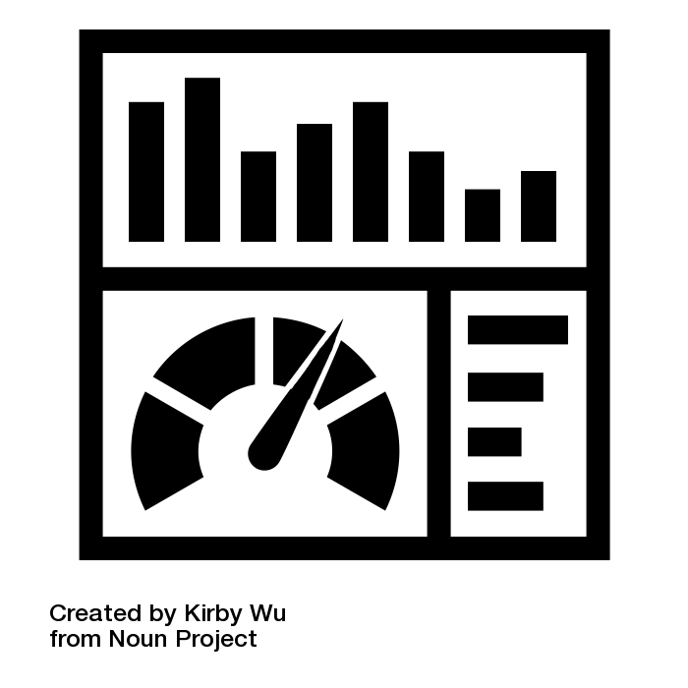




Data Analysis
Quantitative Analysis
Topics, insights, themes, relationships, commitments
Qualitative Analysis
Discovery
Machine Learning
Coding Guide
Further Analysis
DATA TABLES
Quantitative data from analytics and questionnaires.
Qualitative data compiled from comments, participation & feedback.
Human Insight
Public Data Release
Iterative analysis for meaning
Commitment leads
What does it relate to? Who should see it? Is it personal?
Can we act on it? Is it Quotable? What did we do with it?
Data Management Documents
Plan describes sources & repositories and high level processes, protocols provide detailed instructions for those doing the work. Coding guide provides categories used to classify and understand data.
Categorize
Relevance, Theme, Sub-theme, Commitment
Notes:
ICON CREDITS Machine learning by Noura Mbarki from Noun Project
Iinsight by Leo from Noun Project

Slide 7



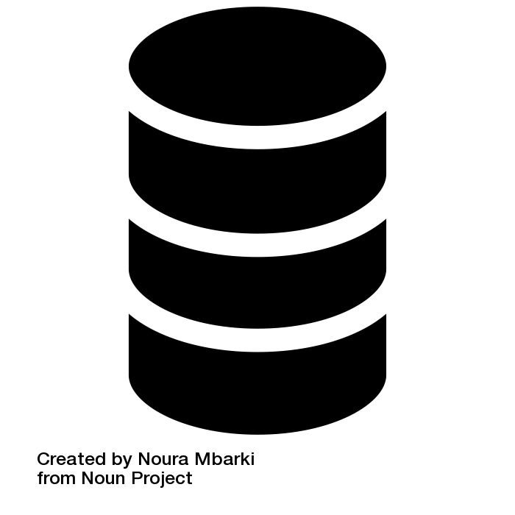

Key Documents
These documents describe the engagement and data processes from the 2016 -18 cycle of creating Canada’s plan on Open Government.
Engagement Strategy
Overview of the plan to engage audiences, collect data and collaborate in creation.
From Engagement to Policy
This presentation that details the process and capacity requirements.
Data Management Documents
Plan describes sources & repositories and high level processes, protocols provide detailed instructions for those doing the work. Coding guide provides categories used to classify and understand data.
Engagement Data
Open datasets of comments for 2014, 2016, 2018 and the get involved questionnaire.
Machine Learning for Qualitative Data
This GCcollab blog post provides some details on one of the pilot project conducted to test the use of AI for categorizing text comments. It also provides links to a related report from Open North that could be useful for future projects. This is the deliverable of a small contract to look at standardization of consultation data. Also created some scripts on GitHub for looking at datasets.
Notes:
Icons are from https://thenounproject.com and are licenced creative commons.

Slide 8
For more information
thomas.kearney@tbs-sct.gc.ca
@thomkearney
alexandre.enkerli@pco-bcp.gc.ca
@montrealgia
Other links:
Report on Pilot Project to use AI for analysis of public engagement input
Designing Public Engagement Toolkit

